Slide 1
Closing Statements in Presidential Debate Between Two Fictional Characters
The Ultimate Fictitious Showdown:
The Three Musketeers:
Alex, David & Luis
Notes:
Luis

Slide 2
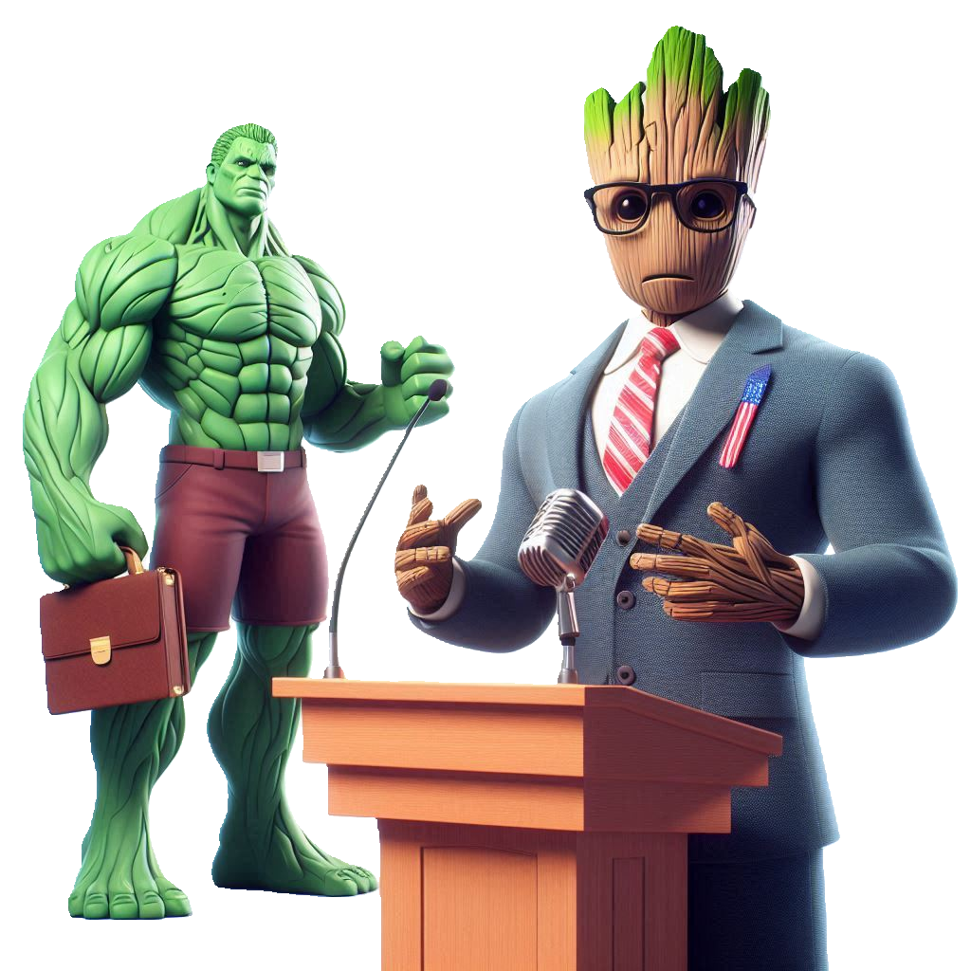
Introduction
Have you ever wondered what would happen if your two favorite fictional characters ran for president?
Well now, you can bring all that headcanon to life with just a tap of your keys.
Notes:
Luis

Slide 3
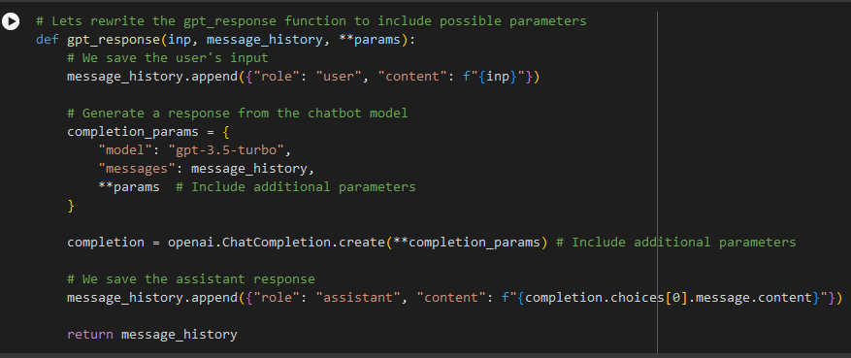
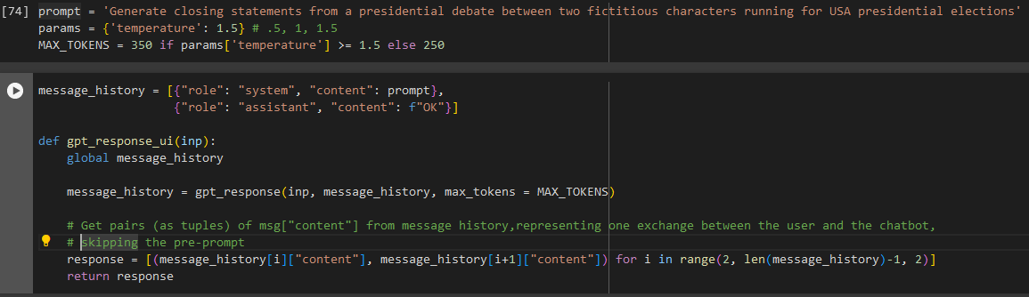
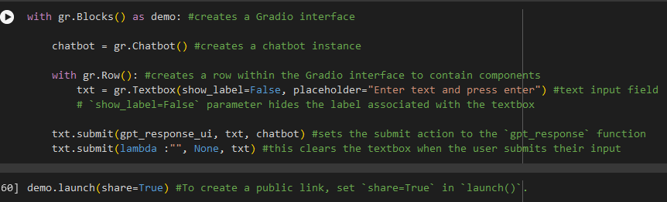
Code Explanation
Notes:
Alex

Slide 4
Results
To demo it yourself : https://0b962d18a898cb7d64.gradio.live
Notes:
David

Slide 5
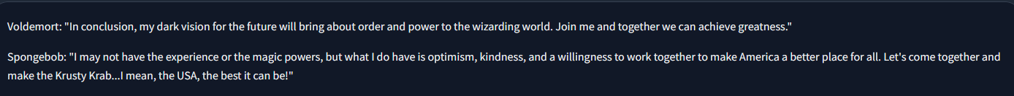
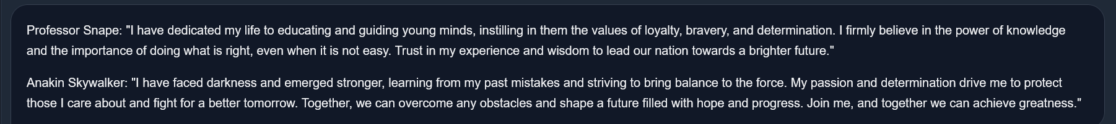
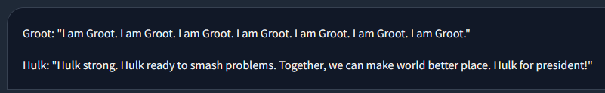
Parameters: Temperature: 1, Max_Tokens: 250
Notes:
Alex

Slide 6
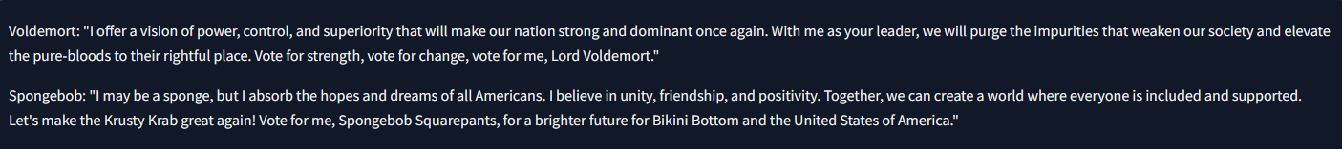
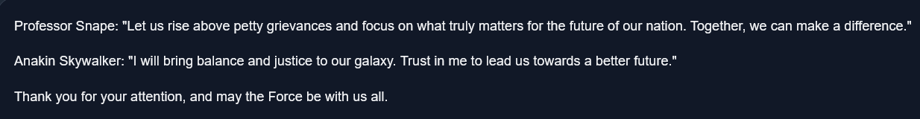
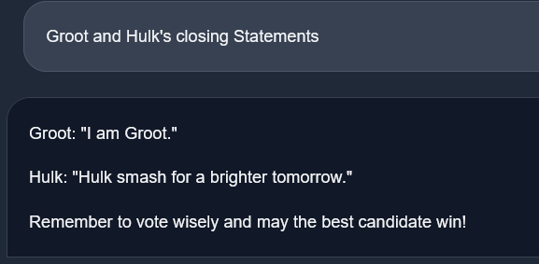
Parameters: Temperature: 0.5, Max_Tokens: 250
Notes:
Luis: With a temperature setting of 0.5, the sentences were noticeably shorter and more general, lacking the distinct character traits and personality nuances that make each candidate unique.

Slide 7
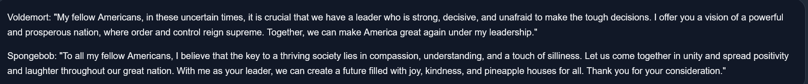
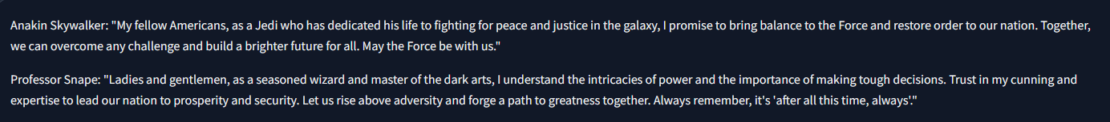
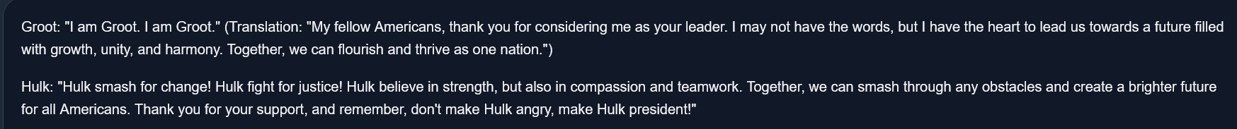
Parameters: Temperature: 1.5, Max_Tokens: 350
Notes:
David- The model will generate highly creative and varied responses, with less predictability. The responses are more random and imaginative, which can sometimes lead to less coherent or more outlandish outputs. Best for highly creative tasks such as storytelling, poetry, or brainstorming, where novelty and diversity are prioritized over consistency.

Slide 8
Lessons Learned
Ran into error running gradio: turns out api key was not set
Had concerns about token limits:
Initially, we wanted to do whole debate between characters but it would cutoff around even 350 tokens.
we settled on closing statements to make it smaller and get to the character’s point.
Decided to only work on configuring temperature:
had trouble coming up with specific prompt which held us up
Notes:
Alex

Slide 9
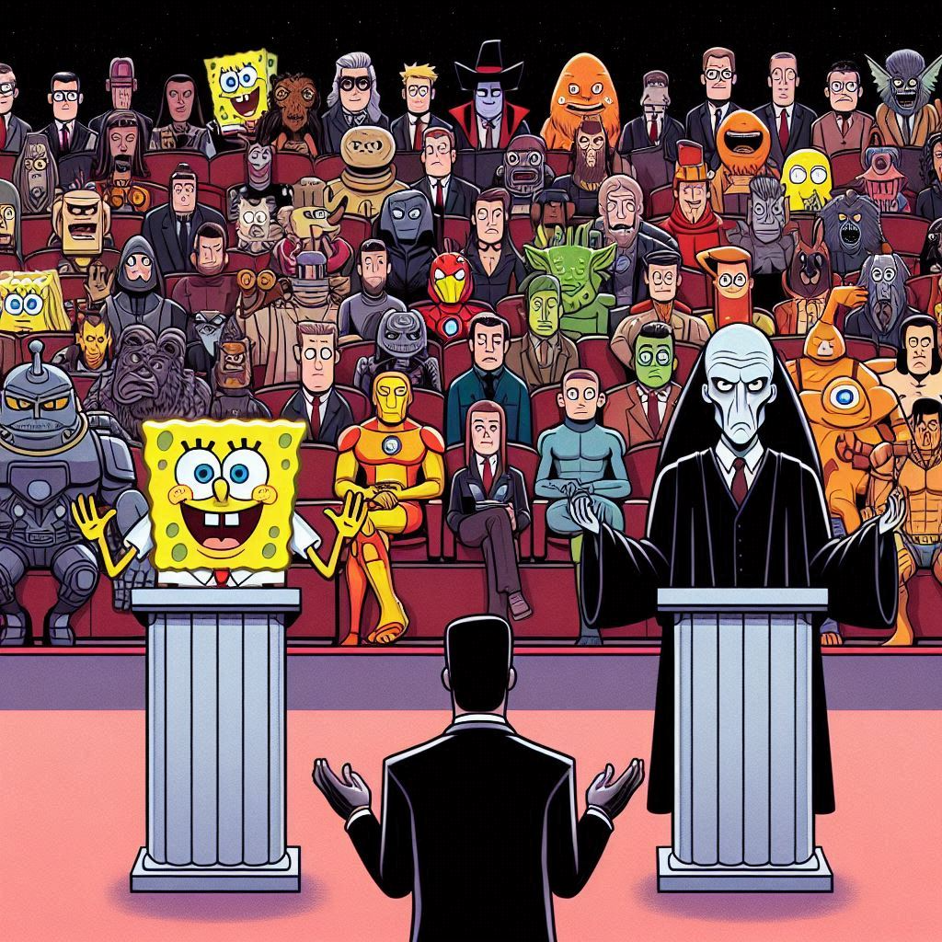
END
Thank You for Attending
3 Musketeers
Notes:
David

